Slide 2
Unit 7: Kubernetes (4hrs)
Introduction to Kubernetes. Kubernetes Cluster Architecture - Brief Overview
Concepts: Pods, Replica Sets, Deployments and Namespaces
Kubernetes Services and Networking
Persistent volumes and persistent volume claims - An Overview
Design of PODS
Understanding labels, selectors, jobs, and schedulers

Slide 3
Once upon a time
In a bustling software company, InnovateTechNepal, a team of developers worked on a revolutionary new application.
They were known for building cutting-edge applications loved by users worldwide. However, as its user base grew, the company ran into serious challenges managing its infrastructure.

Slide 4
The CHAOS
The team recently adopted containerization with Docker. While containers helped streamline application development and deployment, the operations team faced a new set of problems:
Scaling Pains: During peak hours, the app needed more containers to handle the traffic. Manually starting and stopping containers was exhausting, and they are often over- or under-provisioned resources.

Slide 5
The PROBLEM
Unreliable Uptime: Containers sometimes crash. Without an automated system to replace them, users experienced downtime, leading to frustrated customers.
Complex Deployments: Rolling out updates across hundreds of containers was chaotic. Some containers ended up running old versions while others ran new ones, causing inconsistencies.

Slide 6
The PROBLEM
Load Distribution Problems: Traffic wasn’t evenly distributed across containers. Some servers were overloaded while others were idle, leading to performance issues.
The team realized they needed a smarter way to manage their growing fleet of containers. That’s when an engineer named Softee spoke up:

Slide 7
Enter Kubernetes: The Orchestration Wizard
“Imagine,” Softee said, “if we had an orchestra conductor for our containers.
This conductor could:
Ensure the right number of containers are always running.
Automatically restart any that fail.
Scale up or down based on user demand.
Distribute traffic evenly across all containers.
We wouldn’t have to manage containers manually anymore.”

Slide 8
The Transformation
The team was intrigued. Softee introduced them to Kubernetes, a powerful container orchestration platform.
Softee set up Kubernetes, and the team began to see the magic unfold:
Automated Scaling:
Kubernetes monitored traffic and automatically spun up more containers during peak hours and scaled-down during quieter times. No more late-night panic sessions.

Slide 9
The Transformation
Self-Healing Applications:
When a container failed, Kubernetes detected the issue and replaced it instantly, keeping the app running smoothly.
Seamless Updates:
Rolling out updates became a breeze. Kubernetes performed rolling updates, gradually replacing old containers with new ones without any downtime. If something went wrong, it rolled back to the previous version automatically.

Slide 10
The Transformation
Load Balancing:
Kubernetes ensured traffic was evenly distributed across containers, optimizing performance and preventing traffic jams.
Resource Optimization:
Kubernetes allocated just the right amount of CPU and memory to each container, making the most of the company’s infrastructure.

Slide 11
The HAPPY ENDING
Soon, the chaos faded away:
InnovateTechNepal changed its infrastructure into a self-managing system.
Developers no longer have deployment headaches, and the operations team could sleep soundly. The company scaled easily, delighting users with a fast and reliable application.
From that day, Kubernetes became the backbone of InnovateTechNepal infrastructure, empowering them to focus on growth and innovation.

Slide 12
Kubernetes
Kubernetes (K8s) is an open-source container orchestration platform that automates the deployment, scaling, and management of containerized applications.
Originally developed by Google and now maintained by the Cloud Native Computing Foundation (CNCF), Kubernetes helps manage clusters of containers efficiently.

Slide 13
Why Kubernetes?
As modern applications move toward microservices architecture, managing many containers manually becomes complex.
Kubernetes provides:
Automated Scaling – Adjusts resources based on demand.
Self-Healing – Automatically restarts failed containers.
Load Balancing – Distributes network traffic efficiently.
Declarative Configuration – Uses YAML manifests for easy management.
Multi-Cloud & Hybrid Deployments – Works across cloud providers and on-premises environments.

Slide 14
Kubernetes Cluster Architecture
Kubernetes comes with a client-server architecture.
It consists of master and worker nodes, with the master being installed on a single Linux system and the nodes on many Linux workstations.
Kubernetes Cluster mainly consists of Worker Machines called Nodes and a Control Plane.
In a cluster, there is at least one worker node.
The Kubectl CLI communicates with the Control Plane and the Control Plane manages the Worker Nodes.

Slide 15
Kubernetes Cluster Architecture
Kubernetes follows a master-worker architecture:
Control Plane (Master Node)
API Server: Acts as the entry point for all Kubernetes commands.
Scheduler: Assigns workloads (Pods) to worker nodes.
Controller Manager: Ensures the desired state of the system is maintained.
etcd: Stores cluster state and configuration data.
Worker Nodes
Kubelet: Runs on each worker node, ensuring that containers are running.
Container Runtime: Such as Docker or containerd, responsible for running containers.
Kube Proxy: Manages networking and load balancing.

Slide 16
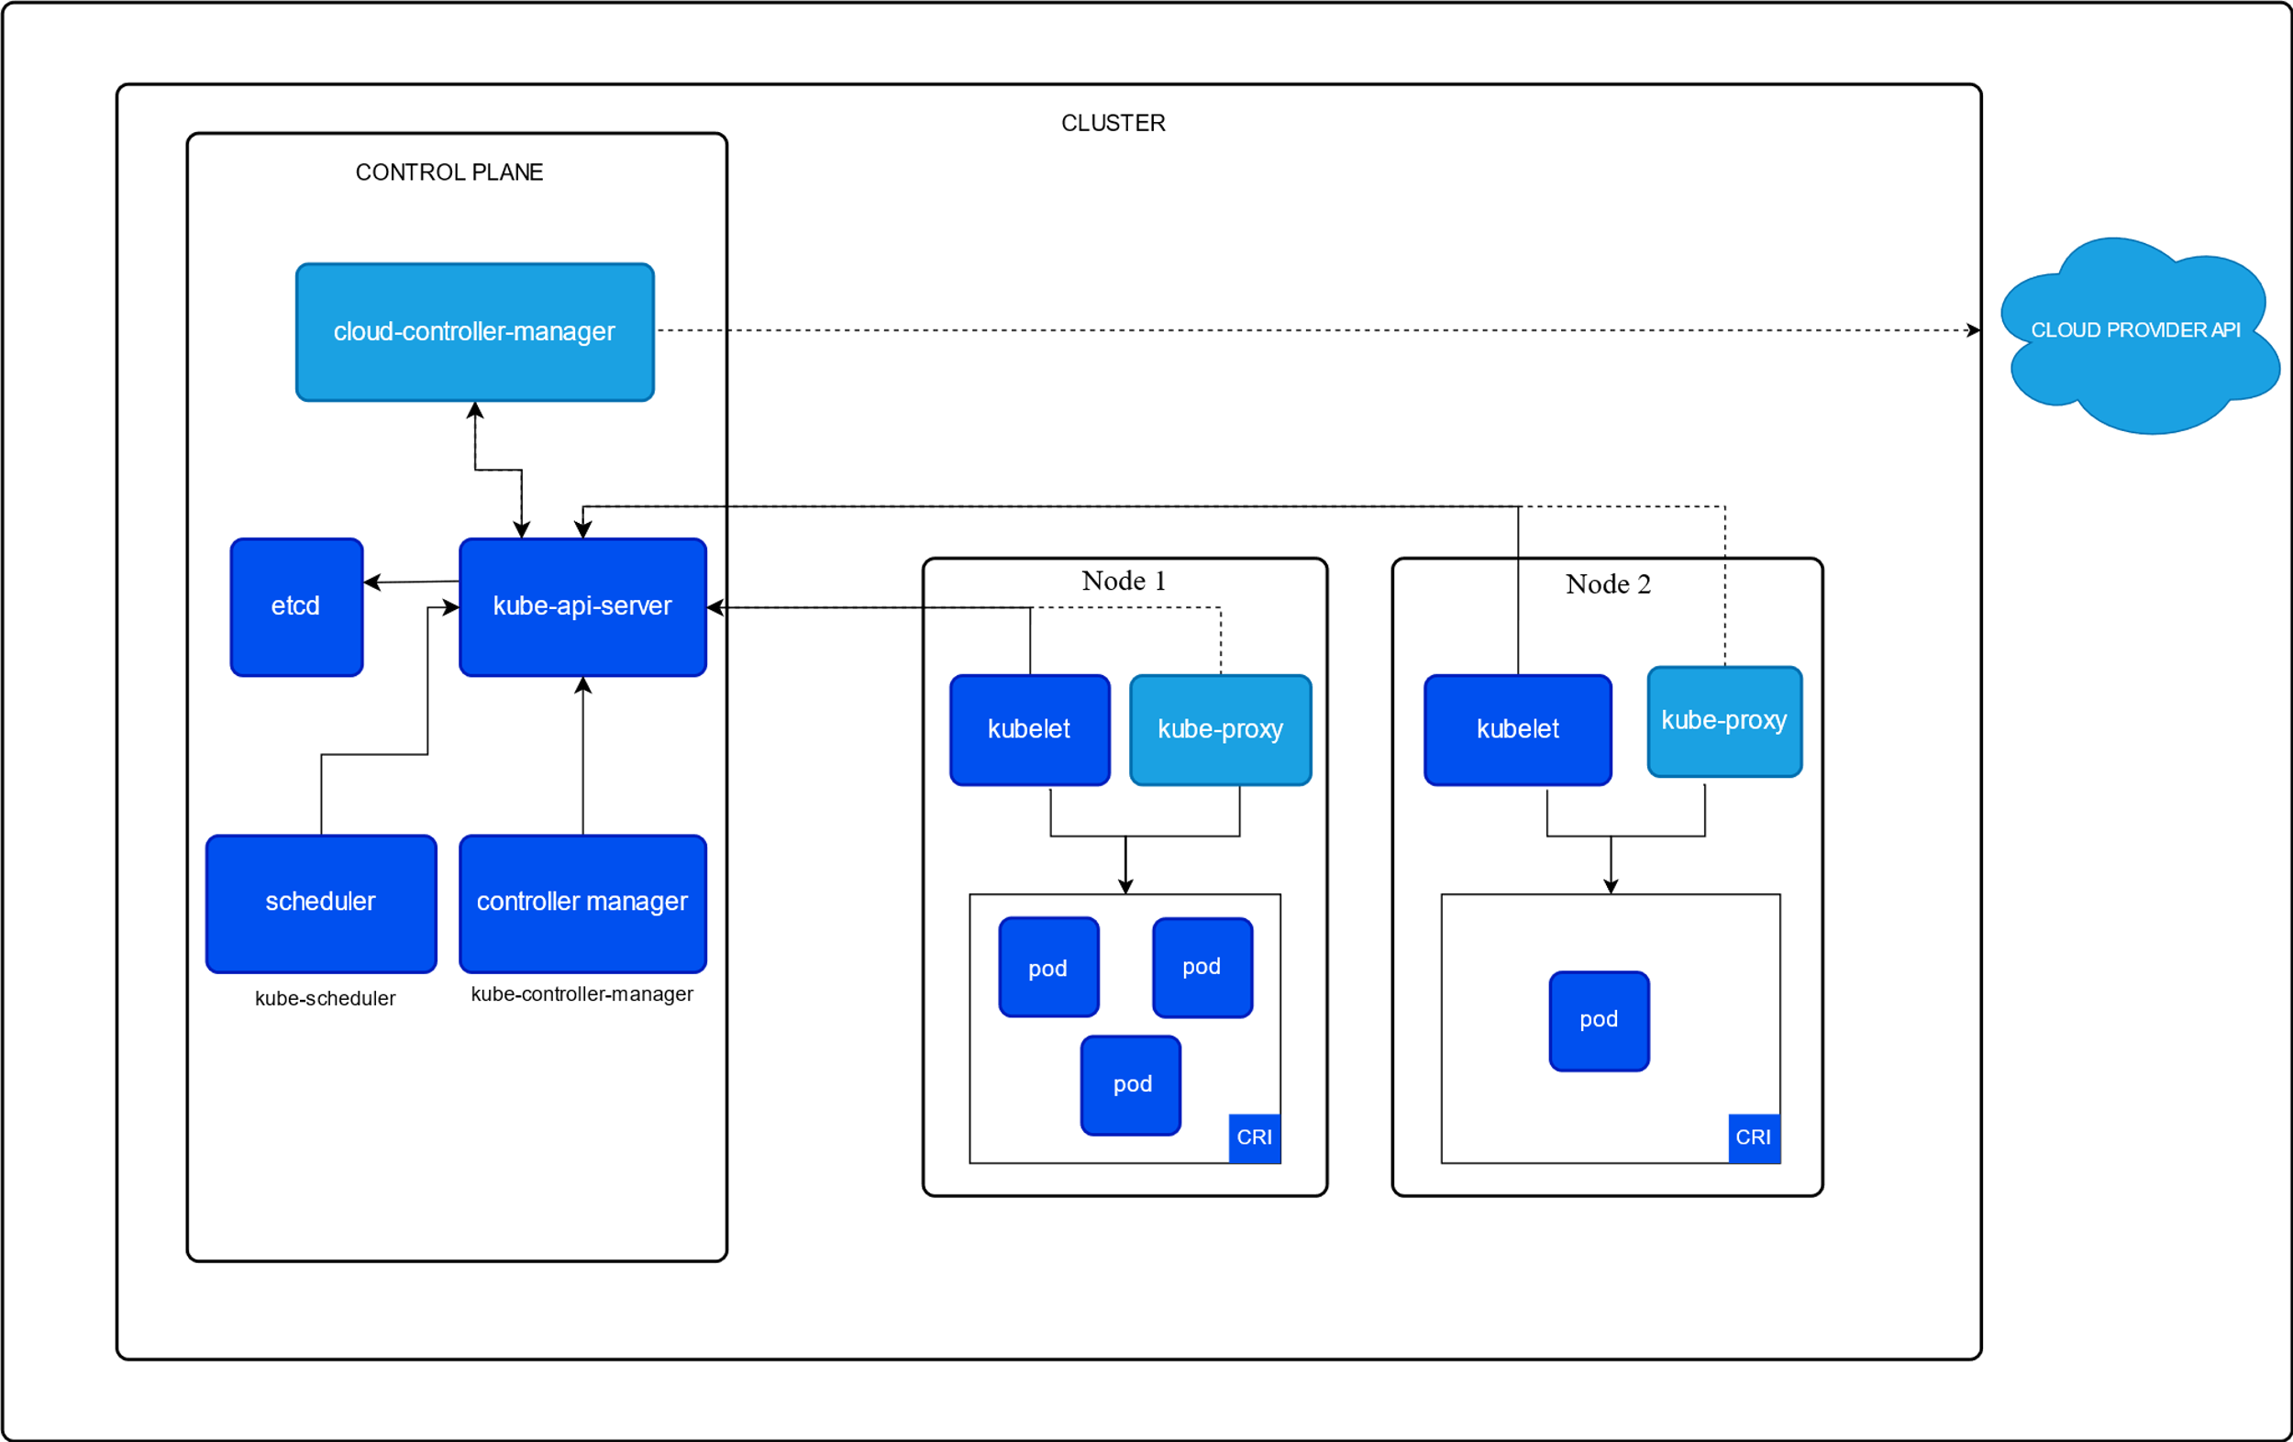

Slide 17
Pods
A Pod is the smallest and most basic deployable unit in Kubernetes.
A Pod can contain one or more containers that share networking and storage.
Containers within a Pod can communicate with each other using localhost.
Pods are temporary, meaning they can be created and destroyed as needed.

Slide 18
A Pod running an Nginx container
apiVersion: v1
kind: Pod
metadata:
name: nginx-pod
spec:
containers:
- name: nginx
image: nginx:latest
ports:
- containerPort: 80

Slide 19
Replica Sets
A ReplicaSet ensures that a specified number of identical Pods are always running.
If a Pod fails, the ReplicaSet automatically replaces it.
It is commonly used with Deployments rather than directly.

Slide 20
A ReplicaSet maintaining 3 Nginx Pods
apiVersion: apps/v1
kind: ReplicaSet
metadata:
name: nginx-replicaset
spec:
replicas: 3
selector:
matchLabels:
app: nginx
template:
metadata:
labels:
app: nginx
spec:
containers:
- name: nginx
image: nginx:latest
ports:
- containerPort: 80

Slide 21
Deployments
A Deployment is a higher-level abstraction that manages ReplicaSets and provides:
Rolling updates to deploy new versions without downtime.
Rollback functionality in case of failure.
Scaling up/down based on demand.

Slide 22
Deployments
apiVersion: apps/v1
kind: Deployment
metadata:
name: nginx-deployment
spec:
replicas: 3
selector:
matchLabels:
app: nginx
template:
metadata:
labels:
app: nginx
spec:
containers:
- name: nginx
image: nginx:latest
ports:
- containerPort: 80

Slide 23
Namespaces
A Namespace is used to logically separate different resources within a Kubernetes cluster.
Helps in organizing environments like dev, staging, and production.
By default, Kubernetes has namespaces like default, kube-system, and kube-public.

Slide 24
Creating a Namespace
apiVersion: v1
kind: Namespace
metadata:
name: my-namespace

Slide 25
Kubernetes Services
Kubernetes networking allows communication between different components inside the cluster and with the outside world.
Since Pods are ephemeral, their IPs change frequently, making it necessary to have stable communication mechanisms.
A Service provides a stable IP address and DNS name to a set of Pods, allowing them to communicate even if individual Pod IPs change.

Slide 26
Types of Kubernetes Services
ClusterIP (Default)
Accessible only within the cluster.
Used for internal communication between Pods.
NodePort
Exposes the service on a static port on each node’s IP.
Allows access from outside the cluster via NodeIP:NodePort.

Slide 27
Types of Kubernetes Services
LoadBalancer
Exposes the service externally using a cloud provider’s load balancer (AWS, GCP, Azure, etc.).
Distributes traffic to backend Pods.
ExternalName
Maps a Kubernetes service to an external DNS name (e.g., database.example.com).
Used for connecting to external services.

Slide 28
Kubernetes Networking
Kubernetes networking allows communication within the cluster and to the outside world.

Slide 29
Networking Components
Pod-to-Pod Communication
Each Pod gets a unique IP address.
Pods in the same node communicate directly.
Pods in different nodes communicate through a CNI (Container Network Interface) plugin.

Slide 30
Networking Components
Pod-to-Service Communication
Services provide a stable IP to route traffic to Pods.
kube-proxy handles the routing.
Ingress Controller (for external traffic)
Ingress manages HTTP/HTTPS traffic from outside the cluster.
Routes traffic to different services based on rules.

Slide 31
End of Lecture 14

Slide 32
Kubernetes Practical

